Slide 1
Chapter 7. Discrete Techniques: Texture Mapping

Slide 2
Chapter 7. Discrete Techniques: Texture Mapping

Slide 3
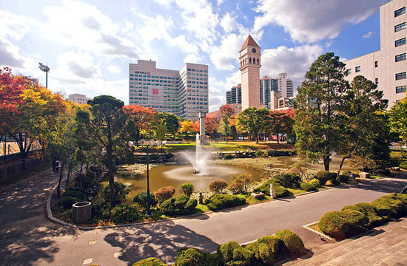
Map textures to surfaces
Texture map
Image mapped to a 3D polygon:
The polygon can have arbitrary size, Shape, and 3D position.
An image

Slide 4
The “st” coordinate system
t (v)
Note: also called “uv” space
1
(s,t)
0
0
1
s (u)

Slide 5
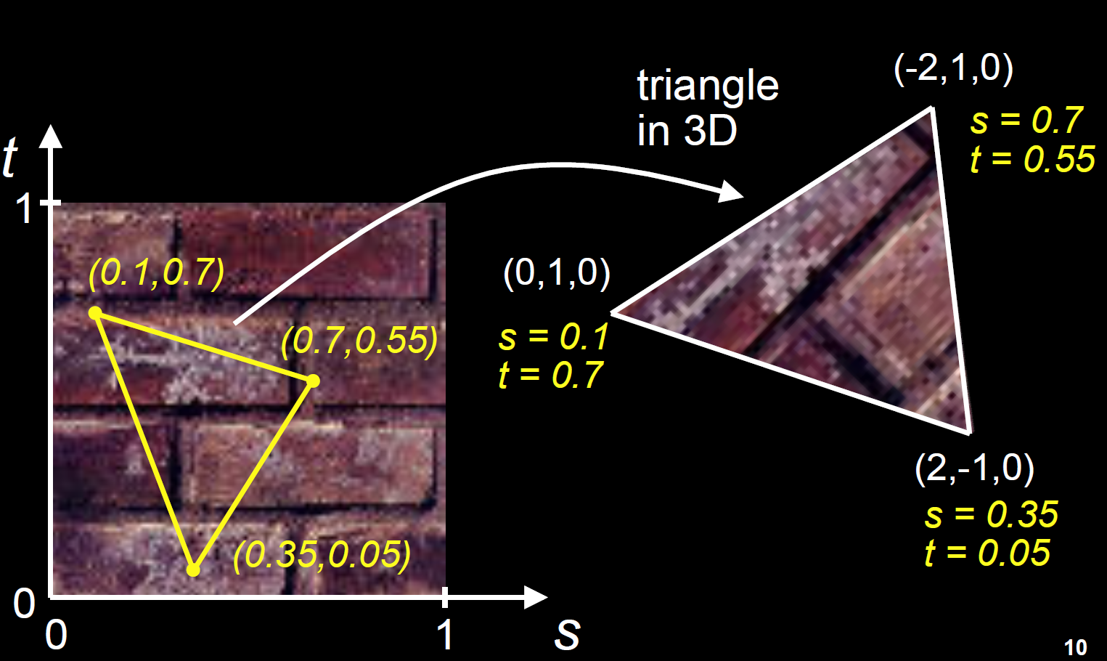
Texture mapping: key slide

Slide 6
Texture mapping: key slide

Slide 7
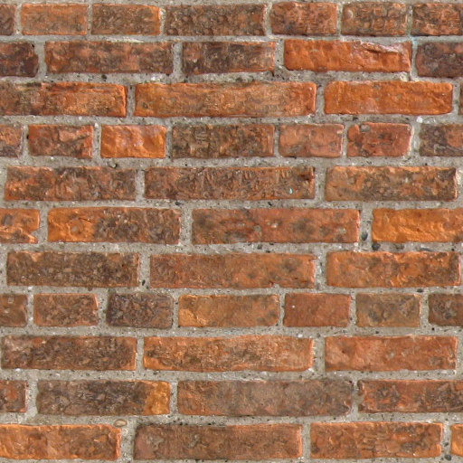
What if texture coordinates are outside of [0,1]
t
1
(s,t)
0
0
1
s

Slide 8
Solution 1: Repeat texture
glTexParameteri(GL_TEXTURE_2D, GL_TEXTURE_WRAP_S, GL_REPEAT)
glTexParameteri(GL_TEXTURE_2D, GL_TEXTURE_WRAP_T, GL_REPEAT)
t
1
(s,t)
0
0
1
s

Slide 9
Solution 2: Clamp to [0,1]
glTexParameteri(GL_TEXTURE_2D, GL_TEXTURE_WRAP_S, GL_CLAMP)
glTexParameteri(GL_TEXTURE_2D, GL_TEXTURE_WRAP_T, GL_CLAMP)
t
Use this color
1
(s,t)
0
0
1
s

Slide 10
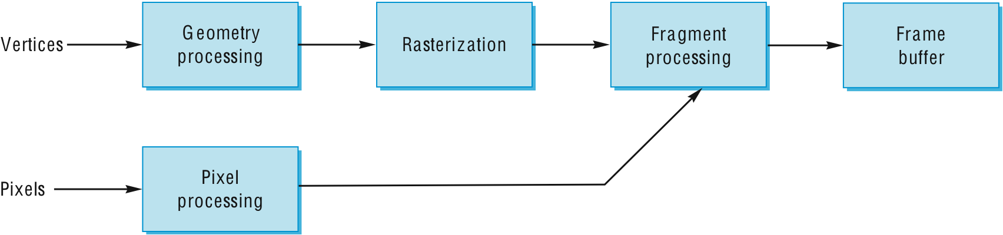
Where does mapping take place?
Mapping techniques are implemented at the end of the rendering pipeline

Slide 11
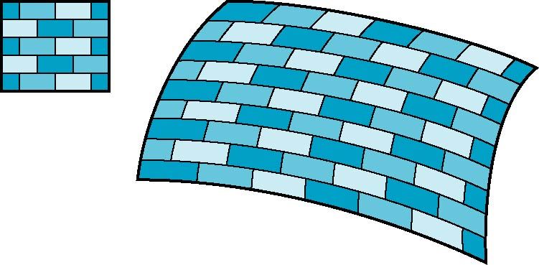
How to compute the map?
Is it simple?
2D image
3D surface

Slide 12
Mapping Functions
Basic problem is how to find the maps
Consider mapping from texture coordinates to a point a surface
Appear to need three functions
x = x(s,t)
y = y(s,t)
z = z(s,t)
But we really want to go the other way
(x,y,z)
t
s

Slide 13
Backward Mapping
We really want to go backwards
Given a pixel, we want to know to which point on an object it corresponds
Given a point on an object, we want to know to which point in the texture it corresponds
Need a map of the form
s = s(x,y,z)
t = t(x,y,z)
Such functions are difficult to find in general

Slide 14
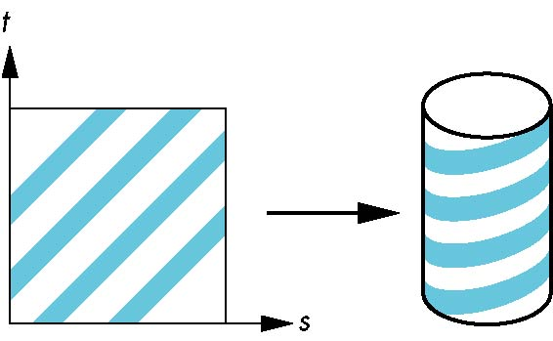
Two-part mapping
One solution to the mapping problem is to first map the texture to a simple intermediate surface
Example: map to cylinder

Slide 15
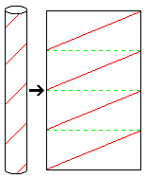
Cylindrical Mapping
How to texture map cylinders and cones:
Given a point P on the surface:
If it’s on one of the caps, map as though the cap is a plane
If it’s on the curved surface:
Use the position of the point around the perimeter to determine $u$
Use the height of the point to determine $v$
$$v$$
$$u$$
z
y
P
x
P
x
$$v= .4$$
$$u= .85$$
z

Slide 16
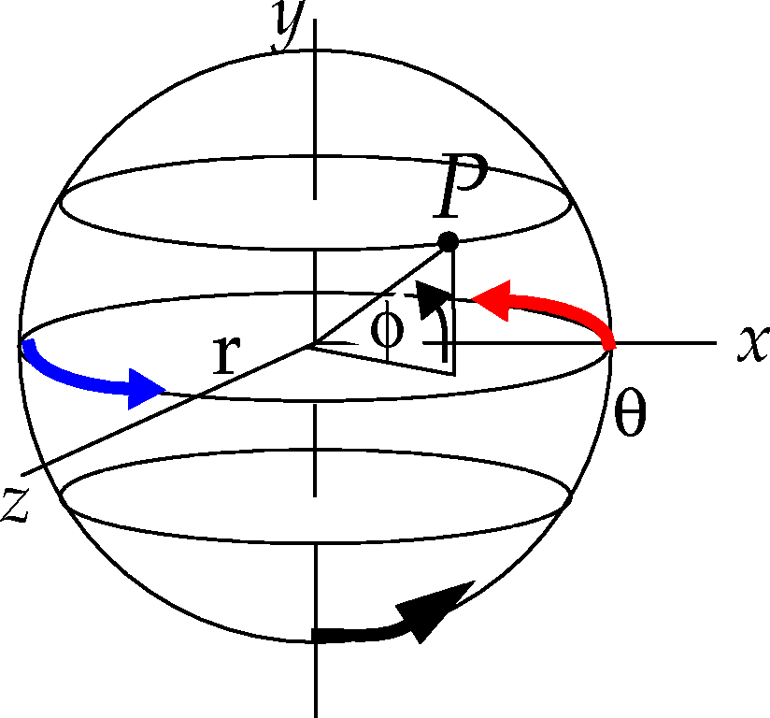
Spherical Map
Texture mapping spheres:
Find $(u, v)$ coordinates for P
We compute $u$ the same we do for cylinders and cones
If $v=0$ or $v=1$, there is a singularity. Set $u$ to some predefined value. (0.5 is good)
$v$is a function of the latitude of P
$$φ= \sin^{−1}{\frac{P_{y}}{r}}$$
$$−\frac{π}{2}≤φ<\frac{π}{2}$$
$r$ = radius
$$v=\frac{φ}{π}+\frac{1}{2}$$

Slide 17
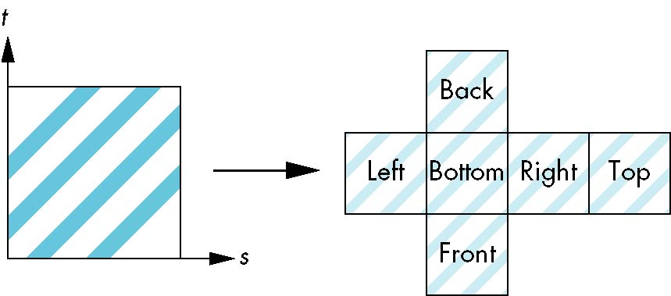
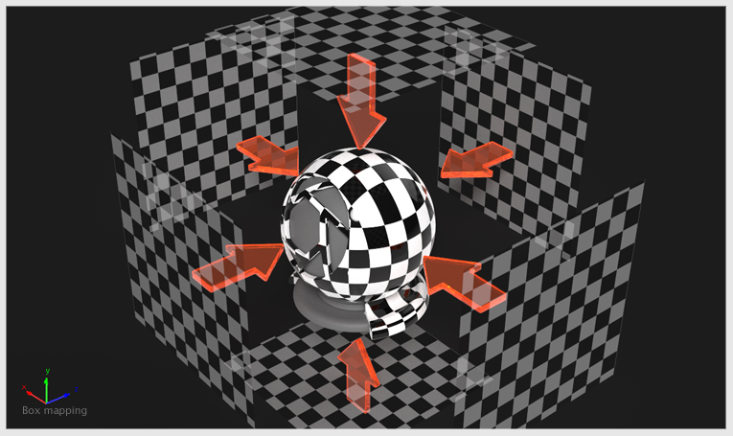
Box Mapping
Easy to use with simple orthographic projection
Also used in environment maps

Slide 18
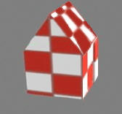
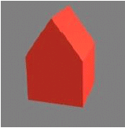
Texture Mapping Complex Geometry
Sometimes, reducing objects to primitives for texture mapping doesn’t achieve the right result.
Consider a simple house shape as an example
If we texture map it using polygons, we get discontinuities at some edges.
Solution: Pretend object is a sphere and texture map using the sphere $\left(u, v\right)$ map

Slide 19
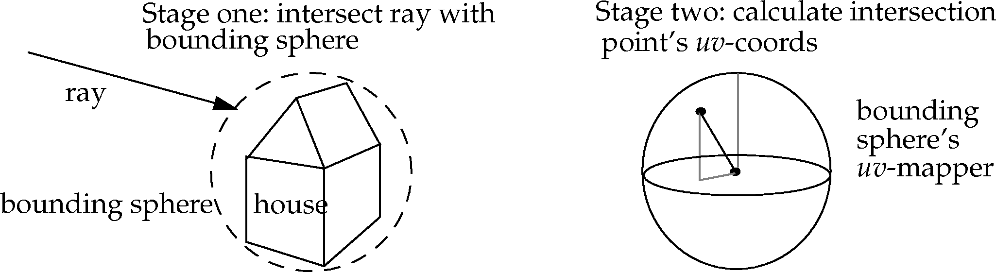
Texture Mapping Complex Geometry
Intuitive approach: Place a bounding sphere around the complex object
Find ray’s object space intersection with bounding sphere
Convert to $(u, v)$ coordinates
We actually don’t need a bounding sphere!
Once we have the intersection point with the object, we just treat it as though it were on a sphere passing through the point. Same results, but different radii.

Slide 20
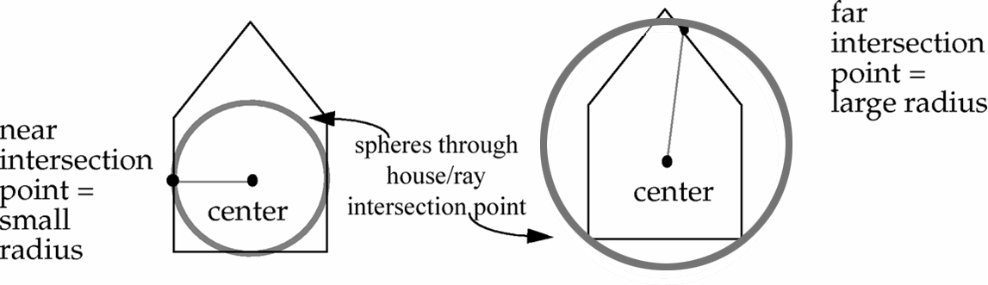
Texture Mapping Complex Geometry
When we treat the object intersection point as a point on a sphere passing through the point, our “sphere” won’t always have the same radius
What radius to use?
Compute radius as distance from defined or computed center of complex object to the intersection point. Use that as the radius for the $\left(u, v\right)$ mapping.

Slide 21
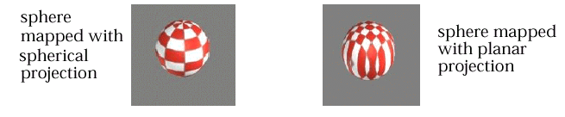
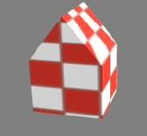
Texture Mapping Complex Geometry
Results of spherical $\left(u, v\right)$ mapping on house:
You can also use cylindrical or planar mappings when texture mapping complex objects
Each has drawbacks
Spherical: warping at the “poles” of the object (the top of the house)
Cylindrical (not shown here): discontinuities at the caps
Planar: one axis is ignored

Slide 22
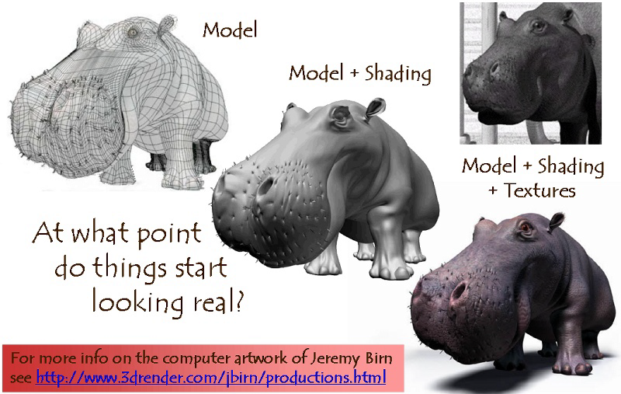
Combining texture mapping and shading

Slide 23
Combining texture mapping and shading
Final pixel color = a combination of texture color and color under standard OpenGL Phong lighting
GL_MODULATE: multiply texture and Phong lighting color
GL_BLEND: linear combination of texture and Phong lighting color
GL_REPLACE: use texture color only (ignore Phong lighting)
Example: glTexEnvf(GL_TEXTURE_ENV,GL_TEXTURE_ENV_MODE, GL_REPLACE);

Slide 24
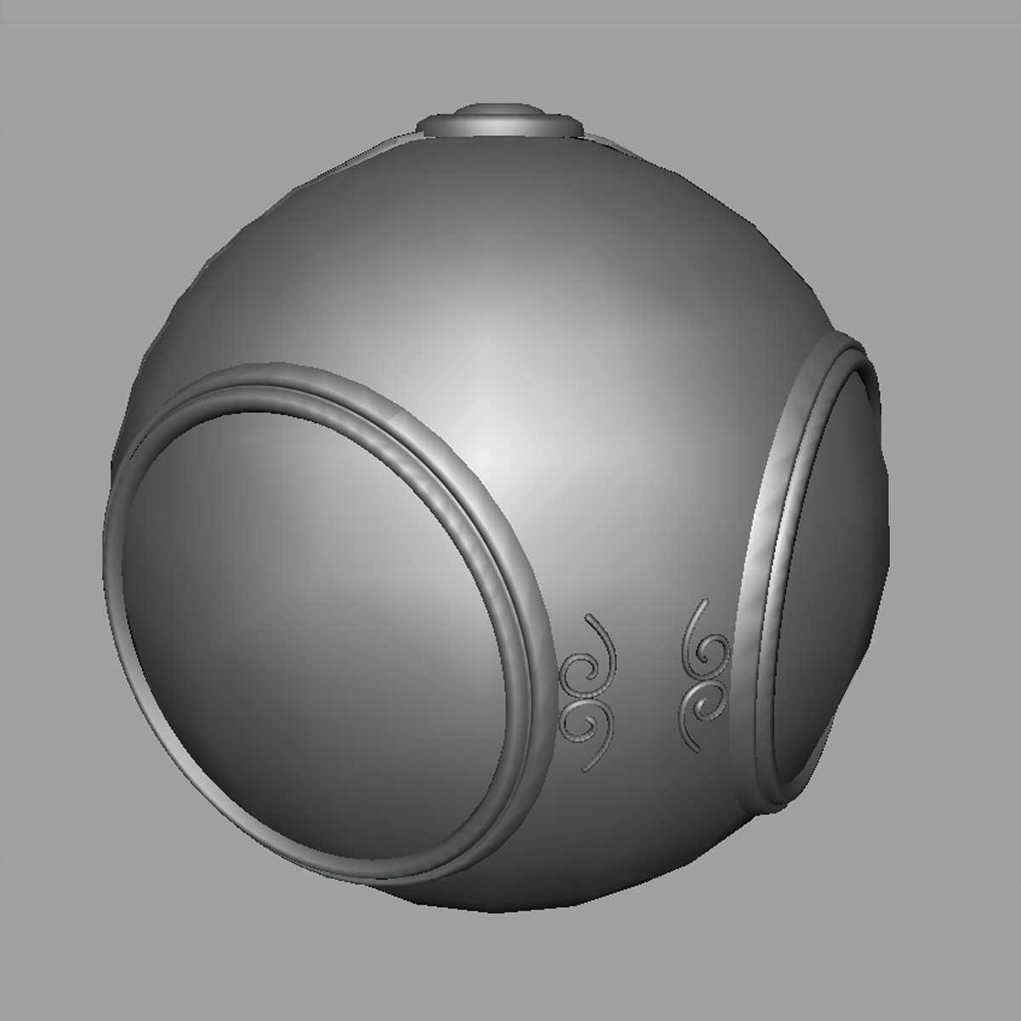
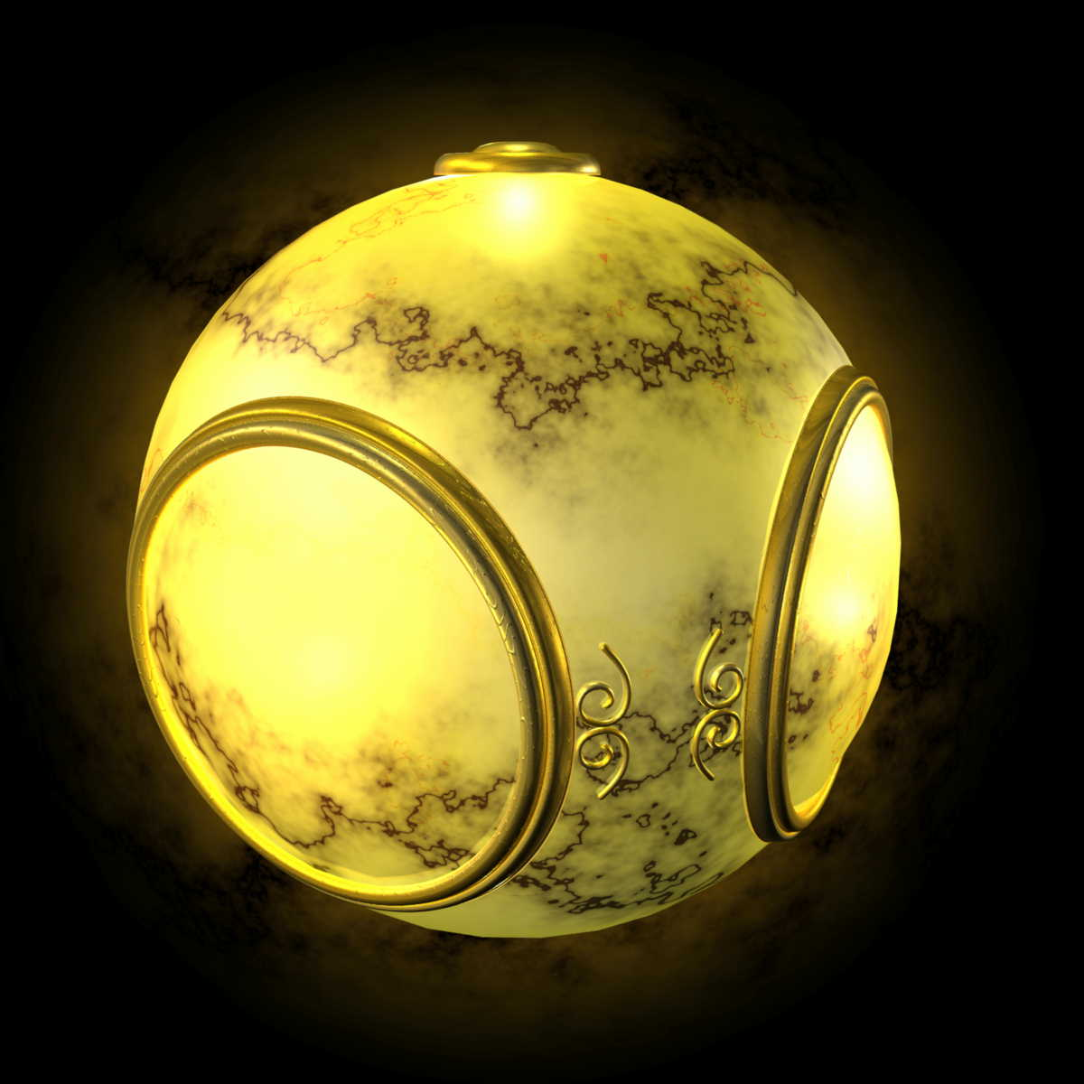
Texture Mapping
geometric model
texture mapped

Slide 25
OpenGL Texture Mapping

Slide 26
Basic Stragegy
Three steps to applying a texture
specify the texture
read or generate image
assign to texture
enable texturing
assign texture coordinates to vertices
Proper mapping function is left to application
specify texture parameters
wrapping, filtering

Slide 27
Specifying a Texture Image
Define a texture image from an array of texels (texture elements) in CPU memory
GLubyte my_texels[512][512][3];
Define as any other pixel map
Scanned image
Generate by application code

Slide 28
Creating a Texture Object
GLuint textures;
glGenTextures( 1, &textures );
glActiveTexture( GL_TEXTURE0 );
glBindTexture( GL_TEXTURE_2D, textures );
glTexImage2D( GL_TEXTURE_2D, 0, GL_RGB, Width, Height, 0, GL_RGB, GL_UNSIGNED_BYTE, image );

Slide 29
Sending a Texture to GPU
glTexImage2D( target, level, components, w, h, border, format, type, texels );
target: type of texture, e.g. GL_TEXTURE_2D
level: used for mipmapping (discussed later)
components: elements per texel
w, h: width and height of texels in pixels
border: used for smoothing (discussed later)
format and type: describe texels
texels: pointer to texel array
glTexImage2D(GL_TEXTURE_2D, 0, 3, 512, 512, 0, GL_RGB, GL_UNSIGNED_BYTE, my_texels);

Slide 30
Mapping a Texture
Based on parametric texture coordinates
Texture Space
Object Space
t
1, 1
(s, t) = (0.2, 0.8)
0, 1
A
a
c
(0.4, 0.2)
b
B
C
0, 0
1, 0
s
(0.8, 0.4)

Slide 31
Texture Parameters
OpenGL has a variety of parameters that determine how texture is applied
Wrapping parameters determine what happens if s and t are outside the (0,1) range
Filter modes allow us to use area averaging instead of point samples
Mipmapping allows us to use textures at multiple resolutions
Environment parameters determine how texture mapping interacts with shading

Slide 32
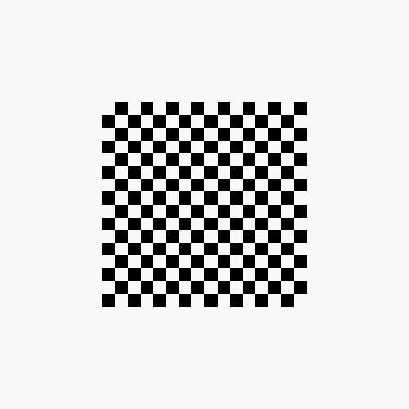
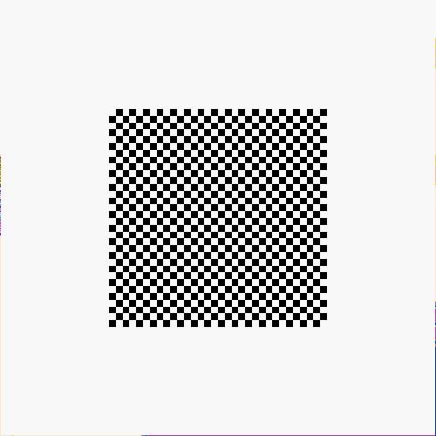

Parameter 1: Wrapping Mode
Clamping: if s,t > 1 use 1, if s,t <0 use 0
glTexParameteri( GL_TEXTURE_2D, GL_TEXTURE_WRAP_S, GL_CLAMP )
Wrapping: use s,t modulo 1
glTexParameteri( GL_TEXTURE_2D, GL_TEXTURE_WRAP_T, GL_REPEAT )
t
s
GL_REPEAT
wrapping
GL_CLAMP
wrapping
texture

Slide 33
Parameter 2: Magnification and Minification
More than one texel can cover a pixel (minification) or
more than one pixel can cover a texel (magnification)
Can use point sampling (nearest texel) or linear filtering
( 2 x 2 filter) to obtain texture values
Texture
Polygon
Texture
Polygon
Magnification
Minification

Slide 34
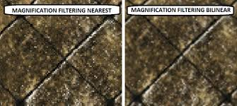
Texture Filtering in Magnification

Slide 35
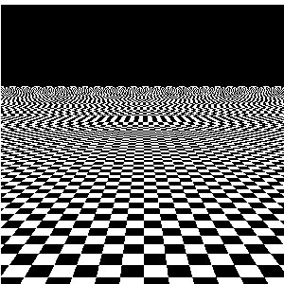
Texture Aliasing Problem in Minification

Slide 36
Parameter2: Magnification and Minification
Modes determined by
glTexParameteri( target, type, mode )
glTexParameteri(GL_TEXTURE_2D, GL_TEXURE_MAG_FILTER,
GL_NEAREST);
glTexParameteri(GL_TEXTURE_2D, GL_TEXURE_MIN_FILTER,
GL_LINEAR);
Note that linear filtering requires a border of an
extra texel for filtering at edges (border = 1)

Slide 37
Summary of Creating Texture Object
GLuint textures;
glGenTextures( 1, &textures );
glActiveTexture( GL_TEXTURE0 );
glBindTexture( GL_TEXTURE_2D, textures );
glTexImage2D( GL_TEXTURE_2D, 0, GL_RGB, Width, Height, 0, GL_RGB, GL_UNSIGNED_BYTE, image );
glTexParameterf( GL_TEXTURE_2D, GL_TEXTURE_WRAP_S,
GL_REPEAT );
glTexParameterf( GL_TEXTURE_2D, GL_TEXTURE_WRAP_T,
GL_REPEAT );
glTexParameterf( GL_TEXTURE_2D, GL_TEXTURE_MAG_FILTER,
GL_NEAREST);
glTexParameterf( GL_TEXTURE_2D, GL_TEXTURE_MIN_FILTER,
GL_NEAREST);

Slide 38
Using Texture Objects
specify textures in texture objects
bind texture object
set texture filter
set texture wrap mode
enable texturing
supply texture coordinates for vertex
coordinates can also be generated

Slide 39
Vertex Shader
Usually vertex shader will output texture coordinates to be rasterized
Must do all other standard tasks too
Compute vertex position
Compute vertex color if needed
in vec4 vPosition; //vertex position in object coordinates
in vec4 vColor; //vertex color from application
in vec2 vTexCoord; //texture coordinate from application
out vec4 color; //output color to be interpolated
out vec2 texCoord; //output tex coordinate to be interpolated

Slide 40
Applying Textures in fragment shader
Textures are applied during fragments shading by a sampler
Samplers return a texture color from a texture object
in vec4 color; //color from rasterizer
in vec2 texCoord; //texure coordinate from rasterizer
uniform sampler2D uTexture; //texture object from application
void main() {
gl_FragColor = color * texture2D( uTexture, texCoord );
}

Slide 41
Linking the uniform with Shaders
GLuint vTexCoord = glGetAttribLocation( program, "vTexCoord" );
glEnableVertexAttribArray( vTexCoord );
glVertexAttribPointer( vTexCoord, 2, GL_FLOAT, GL_FALSE, 0,
BUFFER_OFFSET(offset) );
// Set the value of the fragment shader texture sampler variable
// ("texture") to the the appropriate texture unit. In this case,
// zero, for GL_TEXTURE0 which was previously set by calling
// glActiveTexture().
glUniform1i( glGetUniformLocation(program, "texture"), 0 );

Slide 42
Using an Image as a texture
An image can be used as a texture
OpenGL does not support loading image.
Use other library to load image: ex) OpenCV, QT ( qt-project.org )
Image should be converted to Unsigned Byte data array.

Slide 43
STGA class
A Simple class for loading TGA image
TGA image is the simplest image format.
Download “targa.h” in our homepage
STGA image;
image.loadTGA(“c:\\earthmap_dif.tga”);}
glTexImage2D(GL_TEXTURE_2D, 0, GL_RGB,
image.width, image.height, 0, GL_BGR,
GL_UNSIGNED_BYTE, image.data);

Slide 44
Example Code for reading a texture
GLuint myTex;
glGenTextures(1, &myTex);
STGA img; // requires #include “targa.h”
img.loadTGA(“texture.tga”);
glActiveTexture(GL_TEXTURE0);
glBindTexture(GL_TEXTURE_2D, myTex);
glTexImage2D(GL_TEXTURE_2D, 0, 3, img.width, img.height, 0, GL_BGR,
GL_UNSIGNED_BYTE, img.data);
glTexParameteri(GL_TEXTURE_2D, GL_TEXTURE_MAG_FILTER, GL_LINEAR);
glTexParameteri(GL_TEXTURE_2D, GL_TEXTURE_MIN_FILTER, GL_LINEAR);
img.destroy();
// fragment shader:
uniform sampler2D uTex; // glUniform1i(uTex, 0);
color = texture2D(uTex, texCoord);

Slide 45
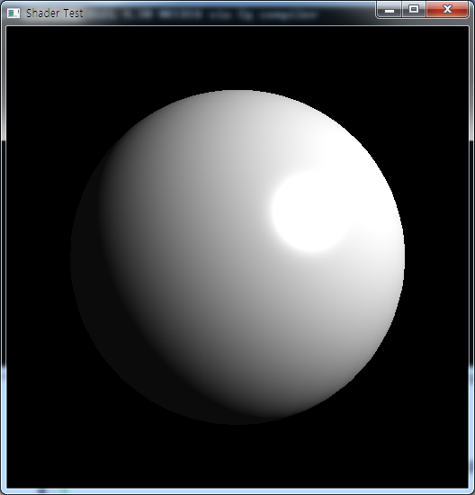
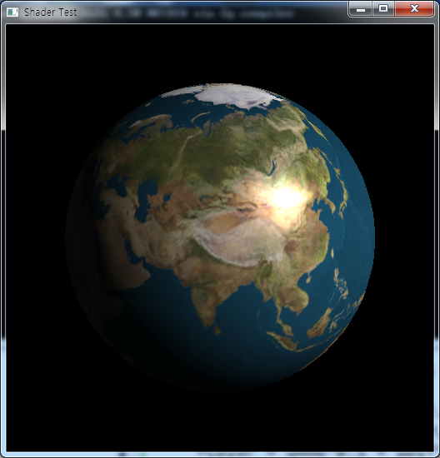
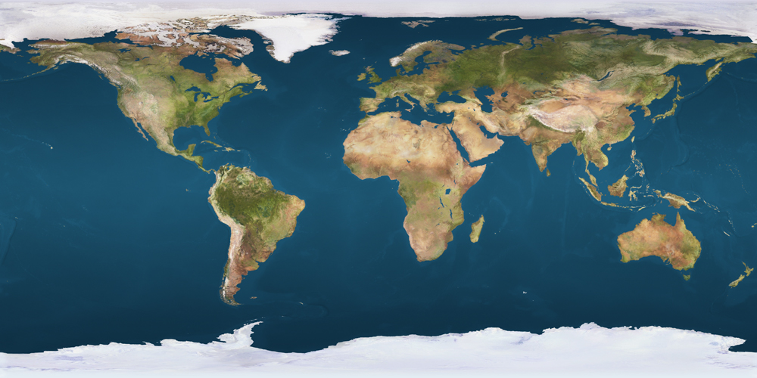
Coding practice: planet earth

Slide 46
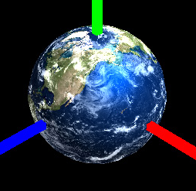
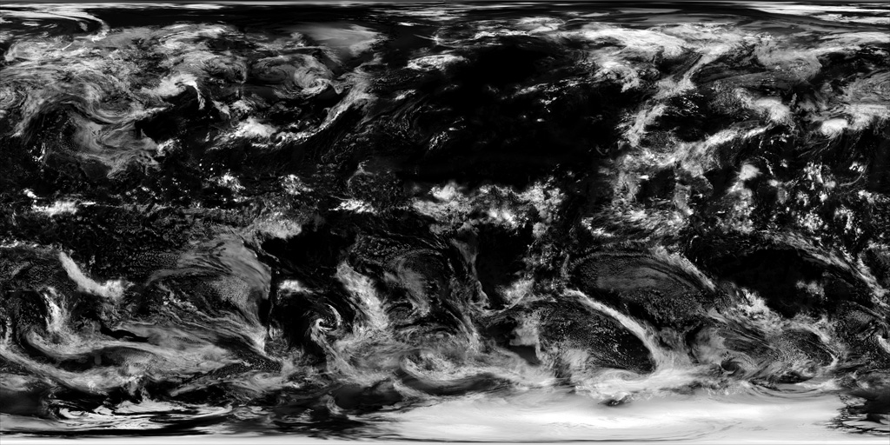
Multi-Texturing
Apply multiple textures at the same surface:

Slide 47
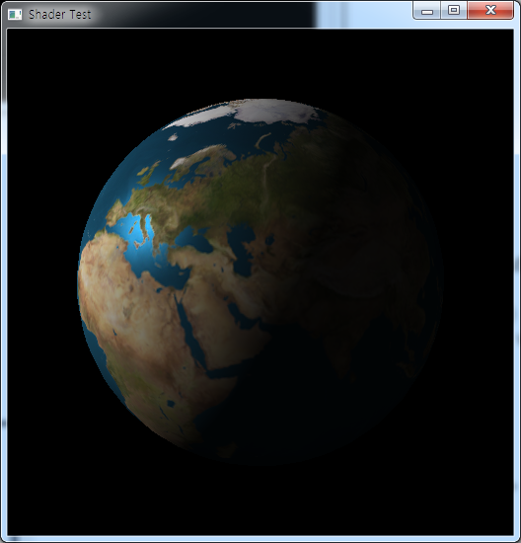
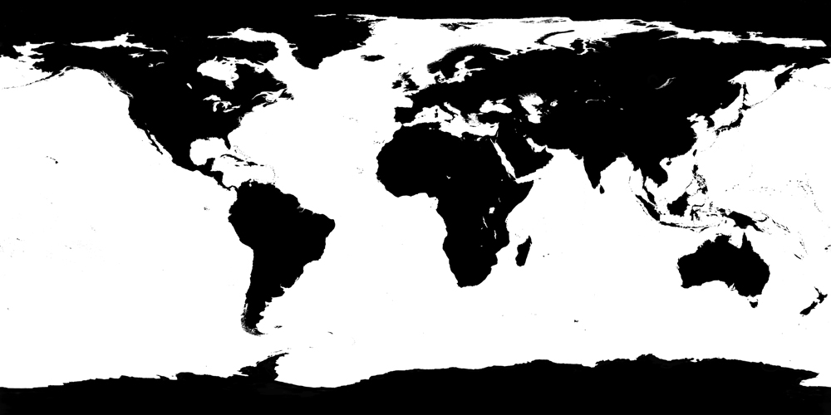
Multi-texturing: Specular Map:
Specify the specular reflectance by giving the additional texture (specular map)

Slide 48
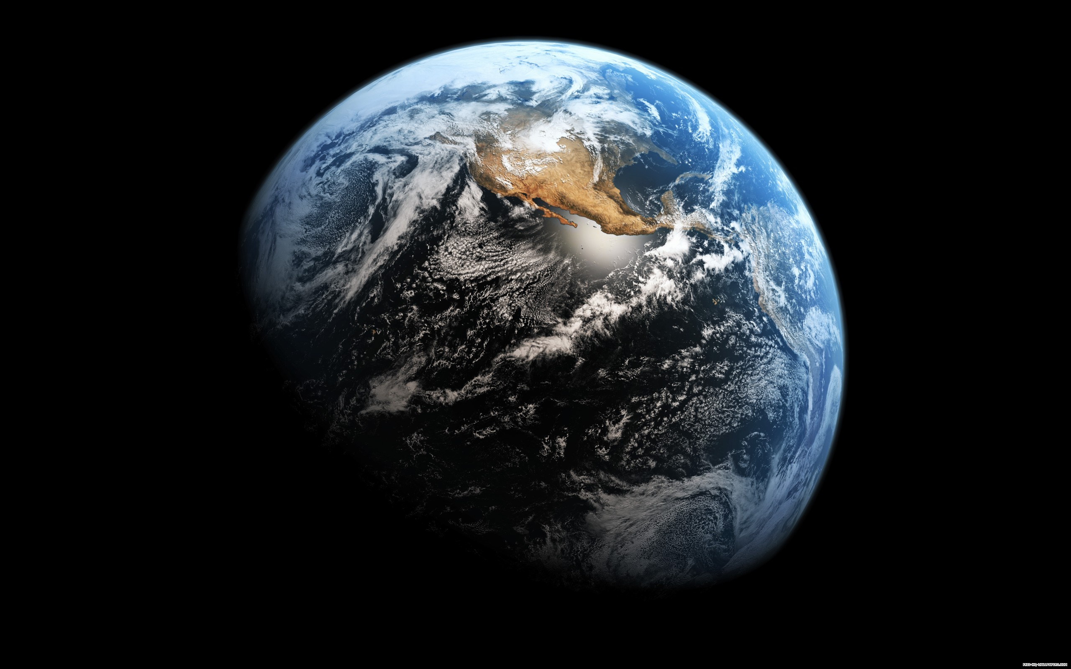
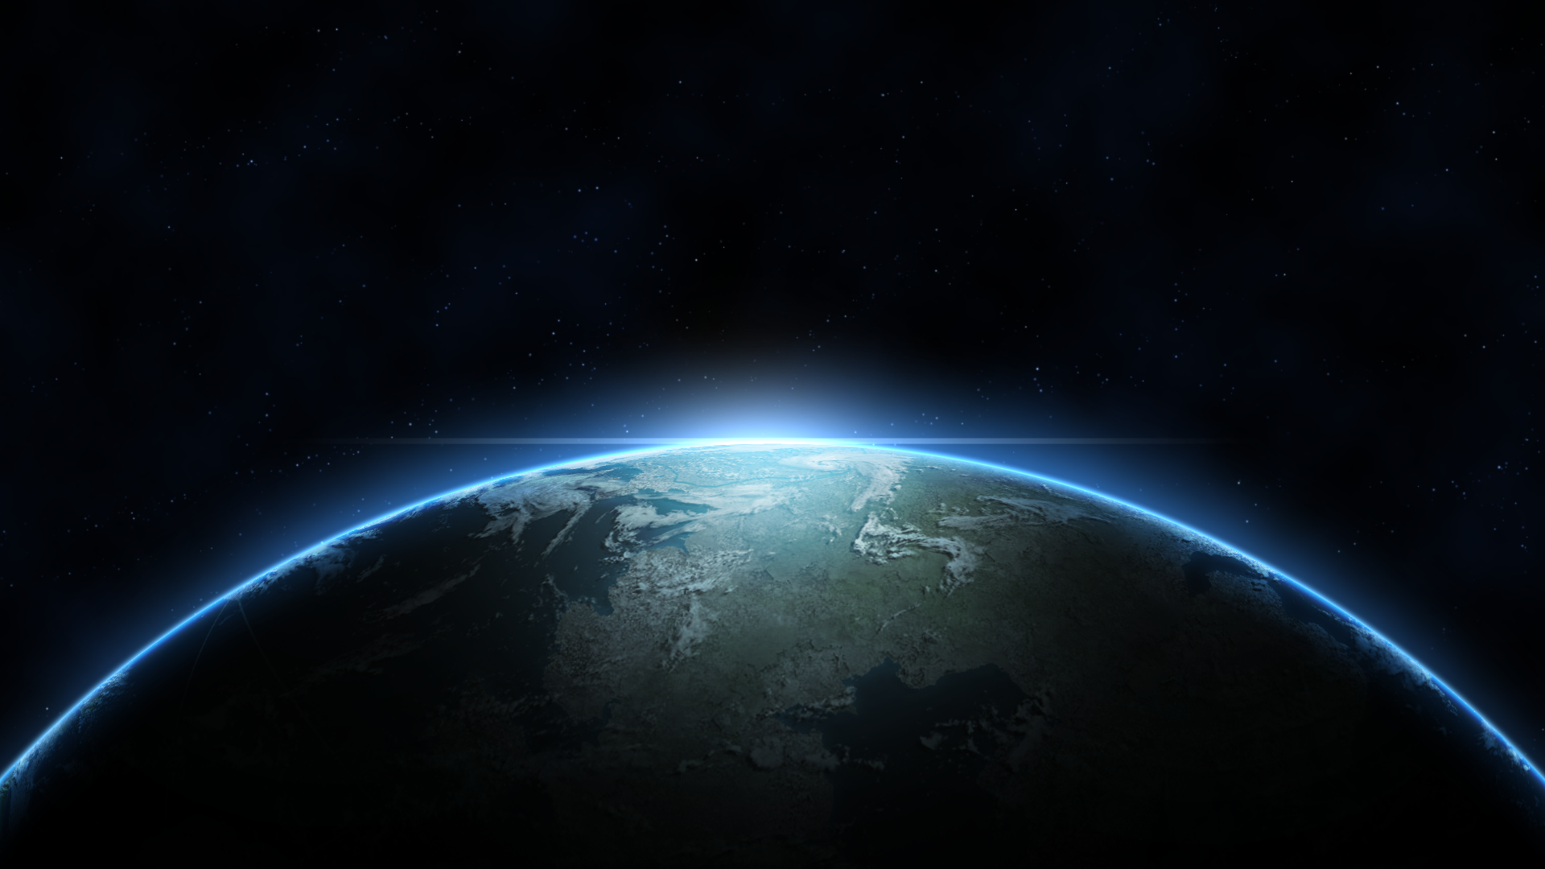
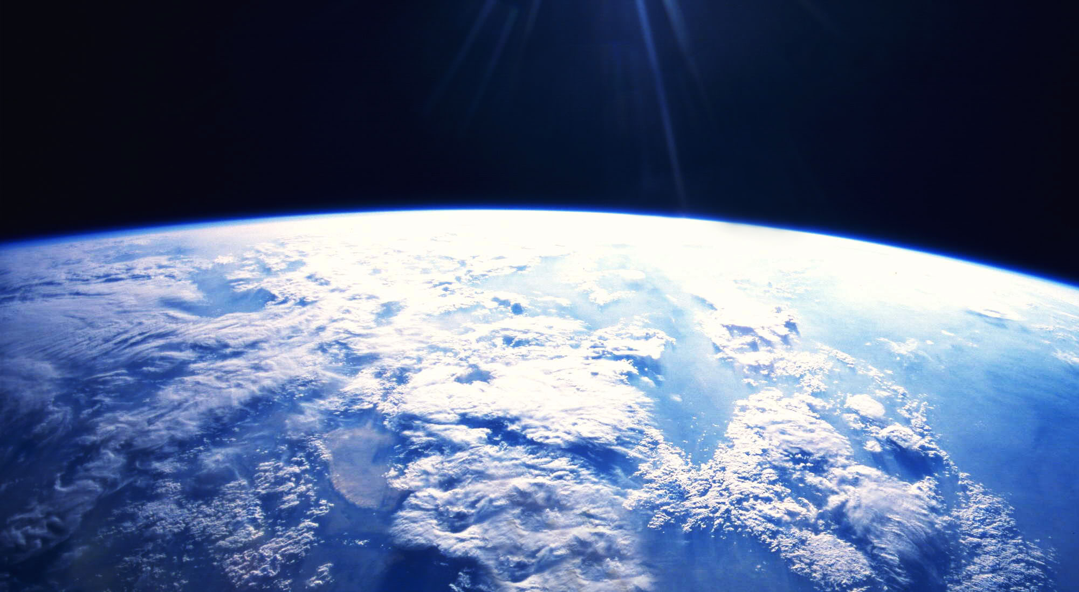
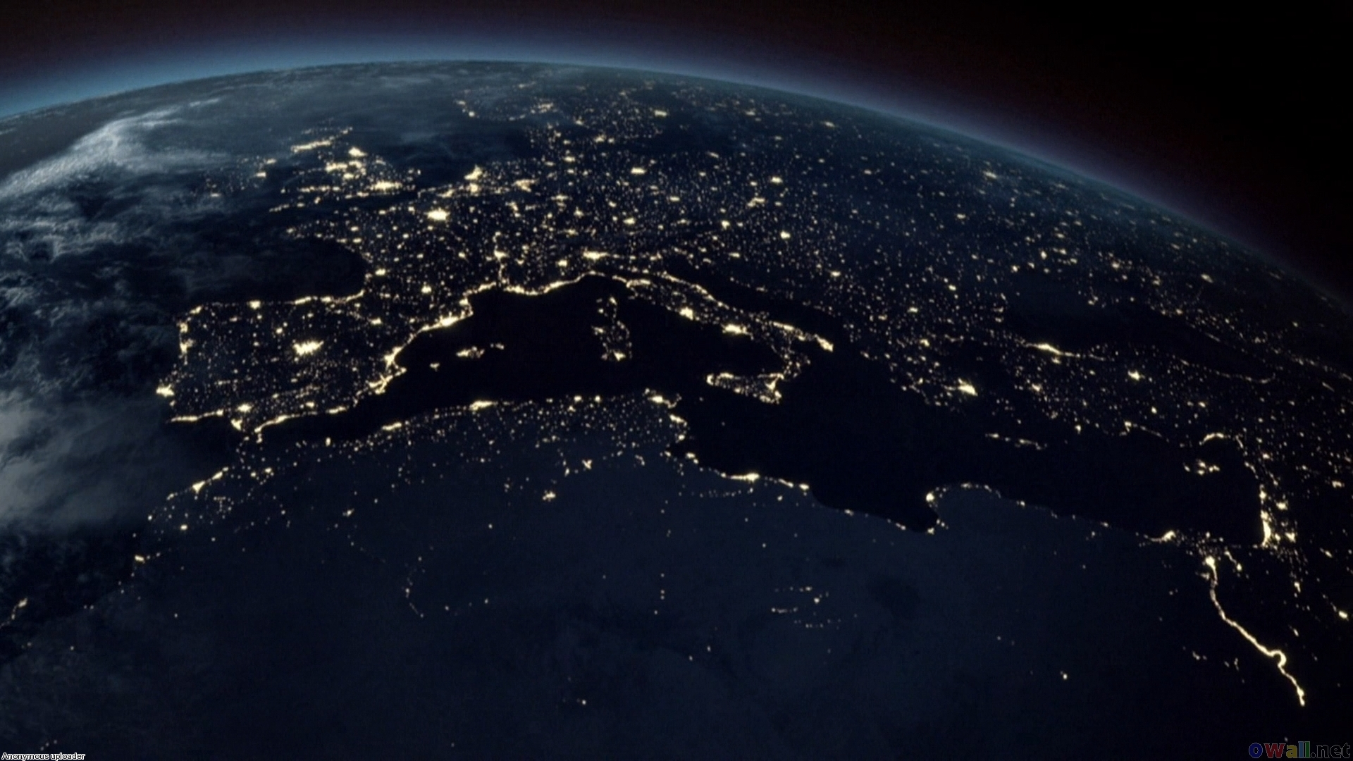
Think more:
Observe the photos of the earth
What effects you need more and how to do implement?

Slide 49
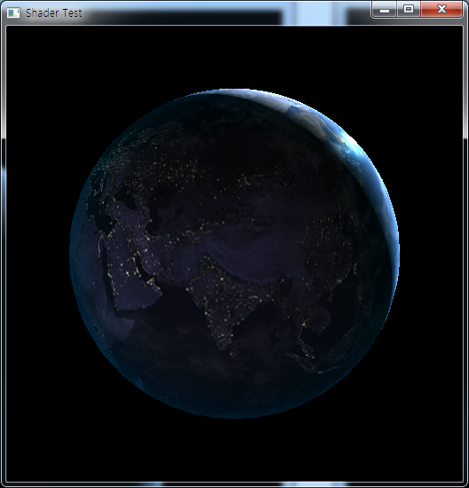
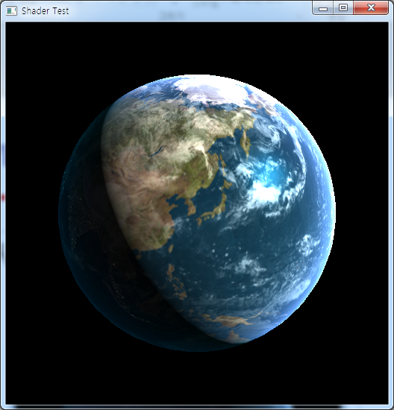
Make your own Planet Earth:

